Slide 1
\LaTeX
For Scientific Documentation
By Ammar Taha Mohamedy
Bibliography Generation

Slide 2
Bib Generation Workflow
.bib database
Input .tex
Multiple entries of formatted references
Choosing Style
\bibliographystyle{<style>}
@type{
cite_key,
key = value,
.
.
.
key = value
}
2. Citing References
\cite {<key>}
author = “”
title = “”
publisher =
3. Using Bib Database
\bibliography {FileName} % without extenstion

Slide 3
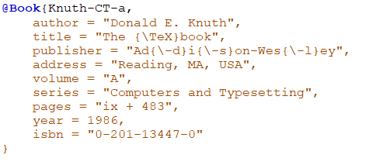

.bib
13.2 The BIBTEX database format
BIBTEX
pdf

Slide 4


Online Bibliography Generators
https://www.mybib.com/

Slide 5
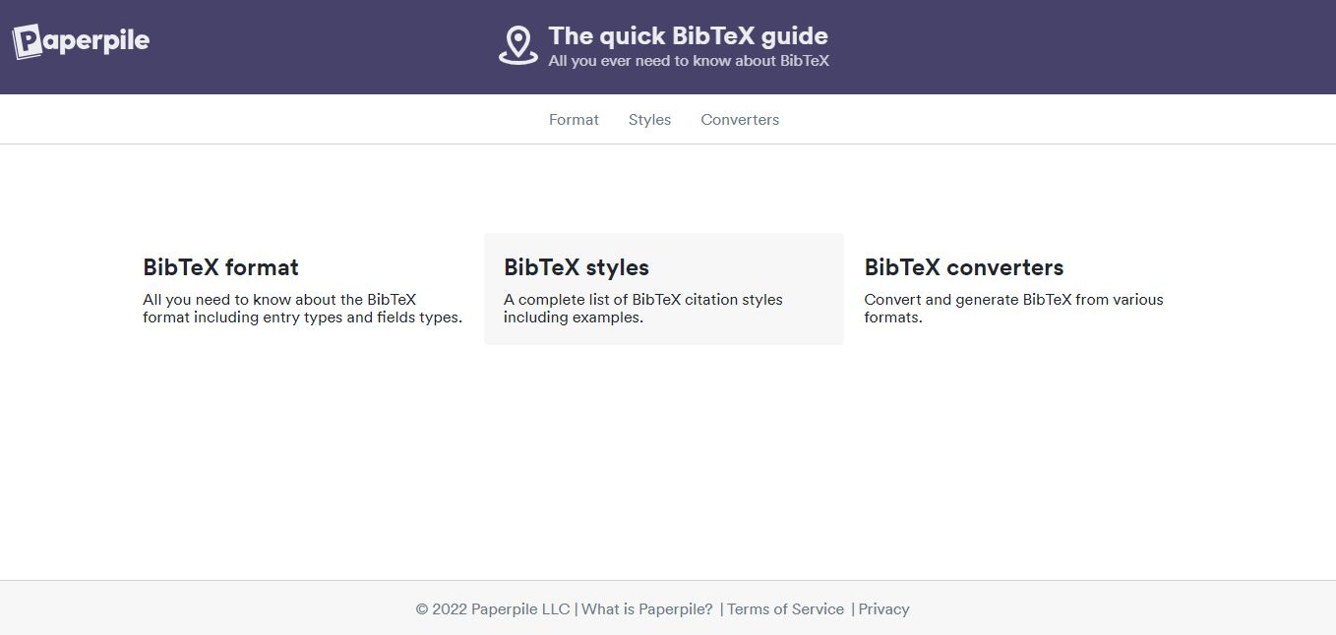
BIBTEX Guide
https://www.bibtex.com

Slide 6
The BIBTEX Program
tex
Compiling Sequence
pdflatex Engine
.bib
pdflatex
bst
aux
BIBTEX
BibTeX
bbl
pdflatex Engine
blg
pdflatex
aux
pdflatex
pdflatex Engine

Slide 7
Cleaning Auxiliary Files
Shell
rm *.aux *.bbl *.blg *.log
Reasons
Consistency and Accuracy: Auxiliary files, such as .aux, .bbl, and .blg files, are generated when you compile a LaTeX document with BibTeX. These files contain information about citations, references, and bibliography styles. If you make changes to your bibliography (e.g., add, modify, or delete references) and do not clean the auxiliary files, the old data may still be present, leading to inconsistencies and inaccuracies in your document.
Reflecting Changes: After modifying your .bib file (the file that contains your bibliography database) or your document's citation style, it's essential to remove the old auxiliary files and regenerate them to ensure that your LaTeX document reflects the most recent changes. Failure to do this can result in outdated references and citation styles.
Debugging and Troubleshooting: Cleaning auxiliary files can help in debugging and troubleshooting BibTeX-related issues. If there are errors or inconsistencies in your bibliography, it's often recommended to start with a clean slate by deleting the auxiliary files and then recompiling the document. This process can help identify and resolve problems more effectively.
Order and Formatting: BibTeX uses auxiliary files to determine the order of references in your document and to format them according to the specified bibliography style (e.g., APA, MLA, Chicago). Cleaning and regenerating these files ensures that references appear in the correct order and are formatted according to the desired style.
Steps
Delete the .aux, .bbl, .blg, and any other generated auxiliary files associated with your LaTeX document.
Recompile your LaTeX document by running LaTeX, BibTeX, and LaTeX again in the correct sequence.
This will generate fresh auxiliary files with updated information from your .bib file and document, ensuring that your citations and references are accurate and up to date.

Slide 8
Thanks for Watching !!

